Slide 1
Day 3, Session 4:
Featurizations in Molecular Sciences

Slide 2
Some notes on notation… (see notation guide)

Slide 3
Descriptors are a set of numerical features contained in vectors or tensors that span the relevant information needed to distinguish samples.

Slide 4
As disappointing as it may be, there is no universally good descriptor (and anyone telling you otherwise is trying to sell you something), but you can ask a few questions to figure out what is most appropriate.

Slide 5
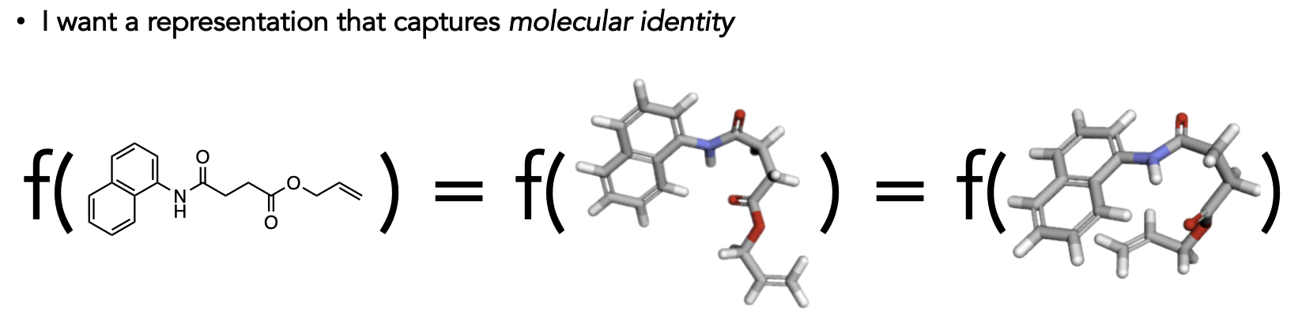
I think a lot in terms of thermodynamics, where we care about configurational space, but others think in terms of chemistry and molecular/materials identity.
Does the configuration of your system matter?
How expansive is the chemistry of your dataset?
Do you care about chemistry at all?
configuration-dependent
configuration-independent
C. Coley
Lecture Notes

Slide 6
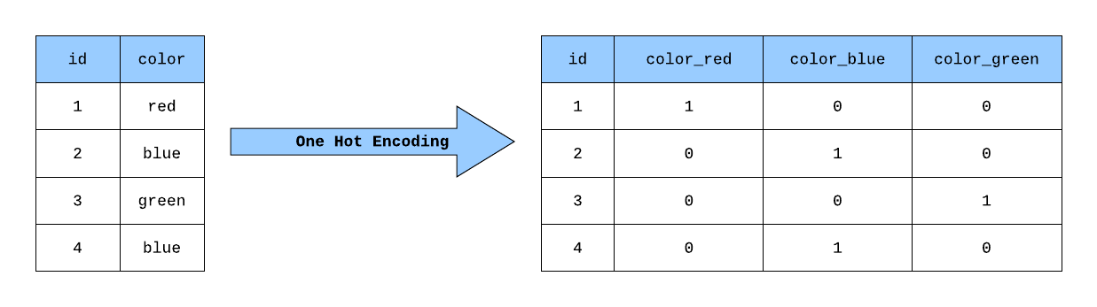
Let’s start with datasets where configuration does not matter… what are our options? One-hot encodings are a binary format that answers a yes/no question.
We can extend these thoughts for chemistries, properties, or characteristics that are present
Is there a hydroxyl group in the molecule?
Is the atom charged?
What is this particle made out of?

Slide 7
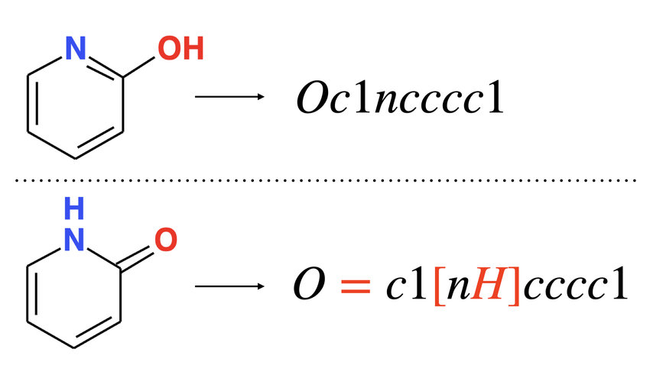
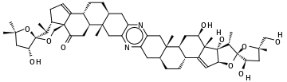
Simplified molecular-input line-entry system (SMILES) and International Chemical Identifiers (InChI) are text strings that standardize positional chemistry.
Pros:
text-based formats mean ability to use NLP models
well-established and highly-interpretable
Cons:
limited to single-molecule representations – interactions are not well-supported
CC(C)(O1)C[C@@H](O)[C@@]1(O2)[C@@H](C)[C@@H]3CC=C4[C@]3(C2)C(=O)C[C@H]5[C@H]4CC[C@@H](C6)[C@]5(C)Cc(n7)c6nc(C[C@@]89(C))c7C[C@@H]8CC[C@@H]%10[C@@H]9C[C@@H](O)[C@@]%11(C)C%10=C[C@H](O%12)[C@]%11(O)[C@H](C)[C@]%12(O%13)[C@H](O)C[C@@]%13(C)CO

Slide 8
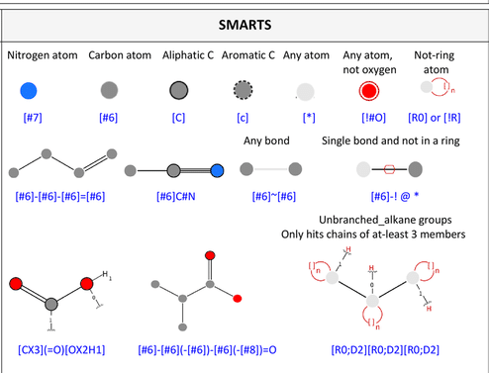
Variations on SMILES exist to give more specificity to our chemical inquiries.
SMARTS (SMILES arbitrary target specification) strings identify functional groups and substructural queries.
SELFIES (Self-Referencing Embedded Strings) extends the SMILES/InChI dictionary to include molecular features such as “Branch”es and “Ring”s.
10.1186/s13321-020-00466-z
Notes:
10.1186/s13321-020-00466-z

Slide 9
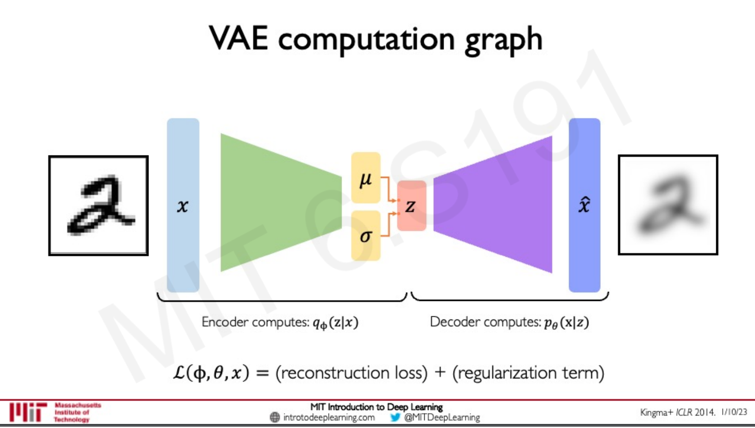
With binary or text-based descriptors, we rely on embeddings, decision trees, and deeper architectures.
It is very common to see a one-hot encoding / SMILES → VAE pipeline in studies.

Slide 10
Okay so come to the dark side and let’s talk about configurational descriptors…

Slide 11
In constructing a configuration-dependent descriptor, we often rely on three concepts:
Smoothness:
Are similar data points nearby each other in feature space?
Completeness:
Does every data point have its own unique set of features?
Symmetry:
What do we know about the physical symmetries of our target?
We can get these aspects by our choice of model to!

Slide 12
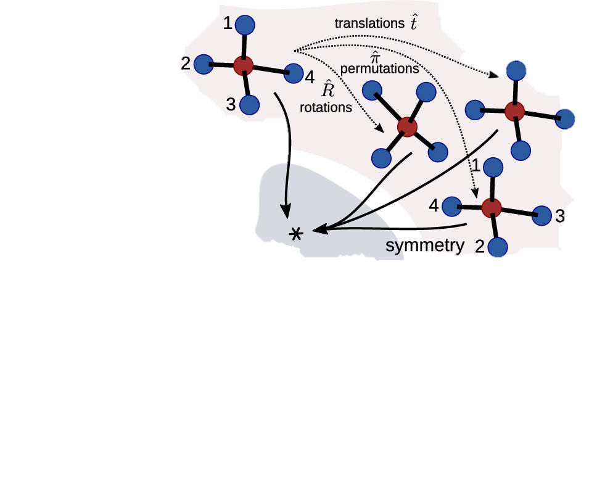
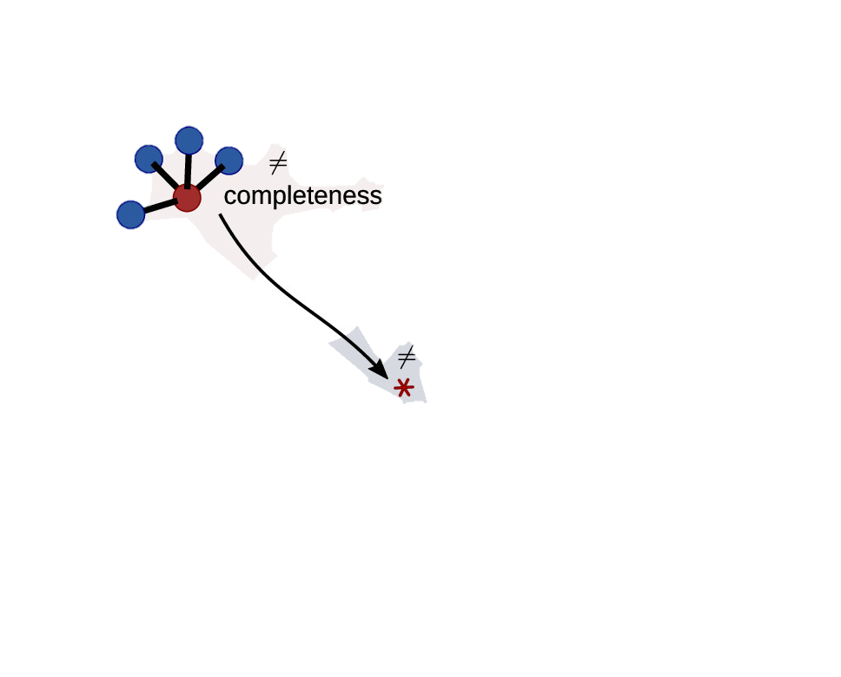
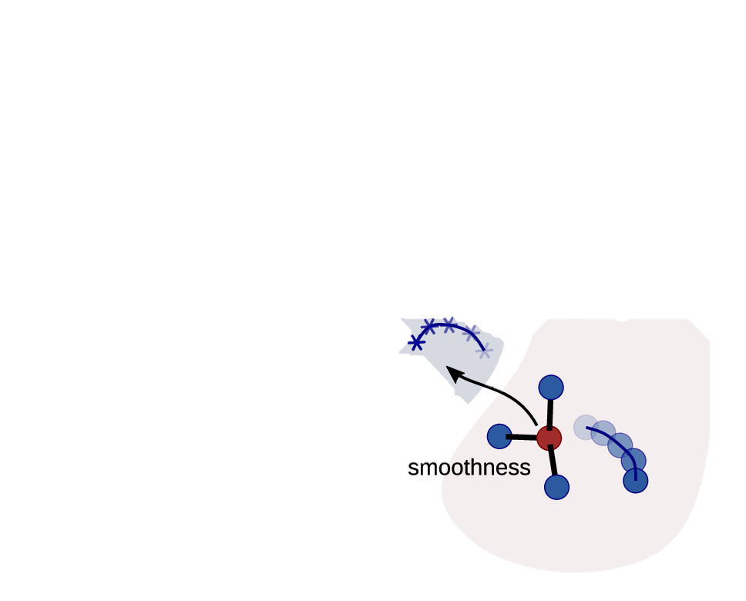
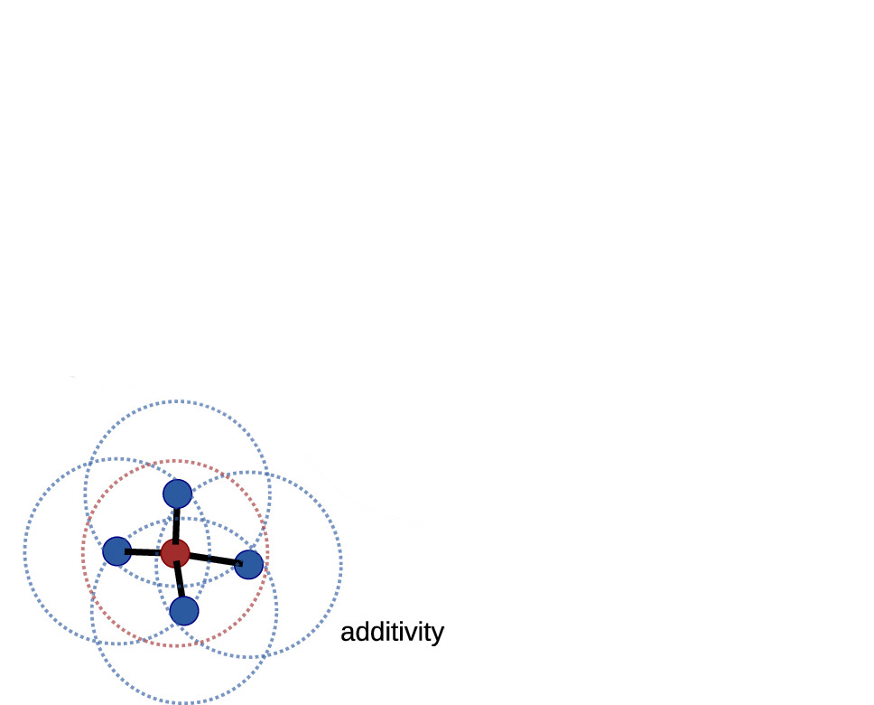
In thermodynamic contexts, what do we want from a representation?
structure
space
feature
space
Chem. Rev. 2021, 121, 16, 9759–9815

Slide 13
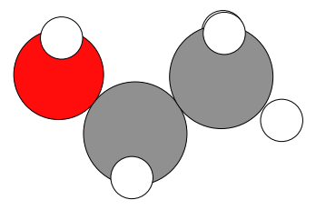
Smoothness:
Are similar data points nearby each other in feature space?
Symmetry:
What do we know about the physical symmetries of our target?
Completeness:
Does every data point have its own unique set of features?
Cartesian/internal coordinates
 | x | y | z
C | -0.47 | 0.514 | 0.007
C | 0.887 | -0.157 | -0.005
O | -1.444 | -0.404 | -0.468
H | -0.746 | 0.833 | 1.016
H | -0.474 | 1.389 | -0.649
H | 1.664 | 0.531 | 0.339
H | 1.14 | -0.499 | -1.014
H | 0.889 | -1.041 | 0.641
H | -1.447 | -1.167 | 0.135
ethanol

Slide 14
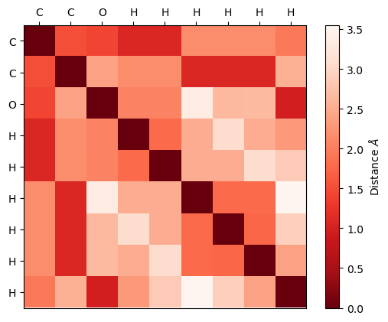
Smoothness:
Are similar data points nearby each other in feature space?
Symmetry:
What do we know about the physical symmetries of our target?
Completeness:
Does every data point have its own unique set of features?
Distance/adjacency matrix
ethanol
these matrices can be used to generate graph-like representations as well

Slide 15
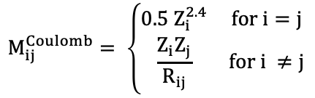
Smoothness:
Are similar data points nearby each other in feature space?
Symmetry:
What do we know about the physical symmetries of our target?
Completeness:
Does every data point have its own unique set of features?
Coulomb matrix
$$M_{ij}^{Coulomb}= \left\{\begin{matrix}0.5 Z_{i}^{2.4} & for i=j \\ \frac{Z_{i}Z_{j}}{R_{ij}} & for i ≠j\end{matrix}\right.$$
ethanol

Slide 16
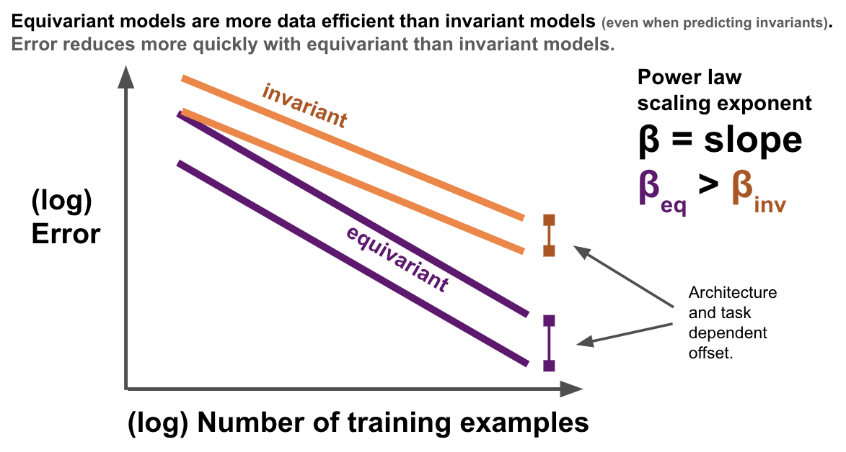
None of these options account for symmetry… why should we care?
Prof. Tess Smidt

Slide 17
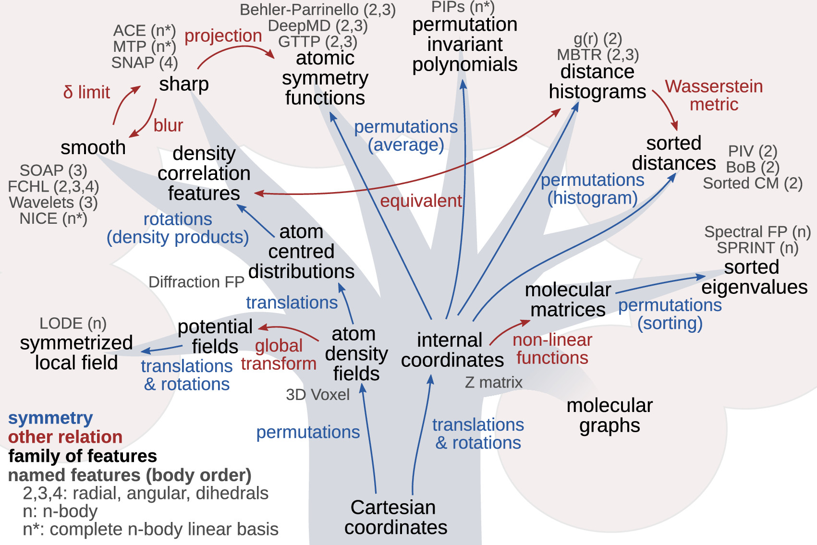
Many symmetrized descriptors exist… (this figure is intentionally overwhelming!)
Many symmetry-adapted frameworks can be expressed in terms of n-body correlations of atom positions. Only difference - the choice of basis

Slide 18
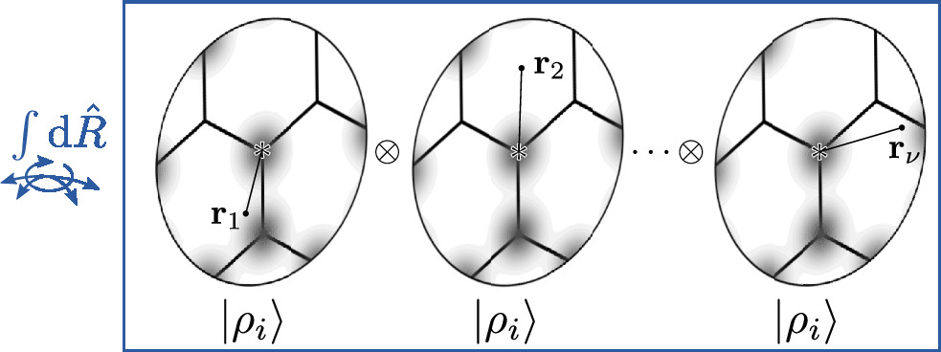
SOAP vectors are the n-body correlations of atomic densities. [math on the board]
Density Expansion
Density Expansion
Density Expansion
Chem. Rev. 2021, 121, 16, 9759–9815
Phys. Rev. B 2013, 87, 184115.

Slide 19
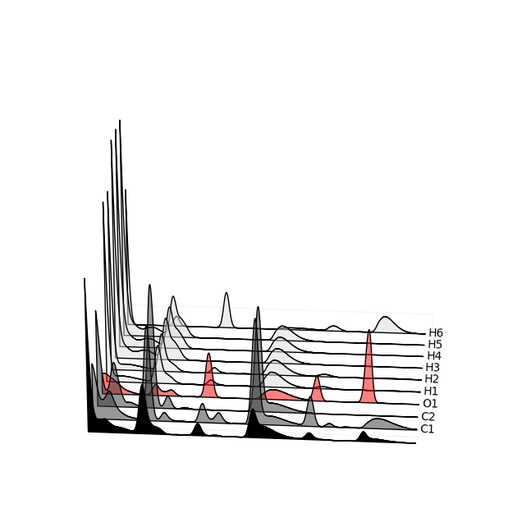
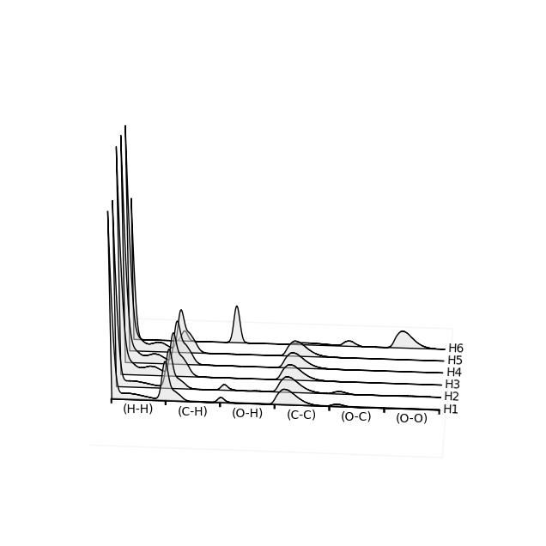
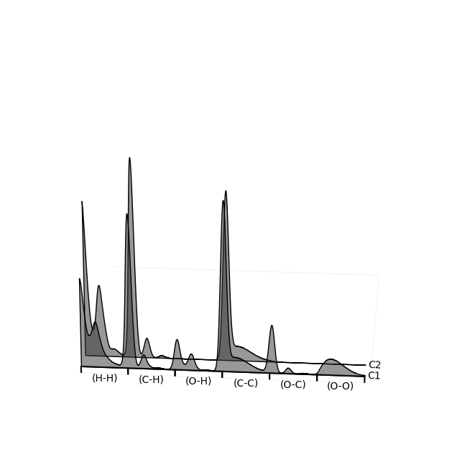
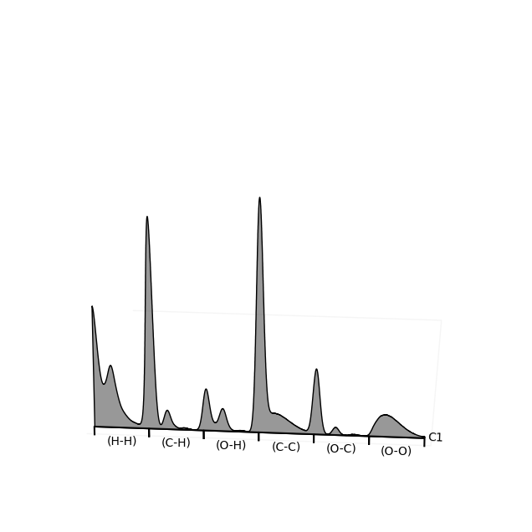

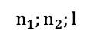
A collection of atoms can be represented by the combination of the atomic fingerprints.
Each atom is represented as a Gaussian density expanded over radial bases (indexed by n) and spherical harmonics (indexed by l). The power spectrum here is the correlation of these densities.
$$n_{1};n_{2};l$$
Power Spectrum SOAP Vectors
Computed with n=12, l=9, rcut=2.0, σ=0.3
Filtered through a Gaussian filter for visual clarity

Slide 20
In the big-data regime, it is possible to “engineer” features by taking advantage of the encoding steps of NN architectures.

